Slide 1
The Limits to Growth: Sustainability and the Circular Economy
Lecture 12: Summary and Outlook
Prof. Dr. Benjamin Leiding
M.Sc. Anant Sujatanagarjuna
M.Sc. Nelly Nicaise Nyeck Mbialeu

Slide 2
License
This work is licensed under a Creative Commons Attribution-ShareAlike 4.0 International License. To view a copy of this license, please refer to https://creativecommons.org/licenses/by-sa/4.0/ .
Updated versions of these slides will be available in our Github repository.

Slide 3
News/Updates

Slide 4
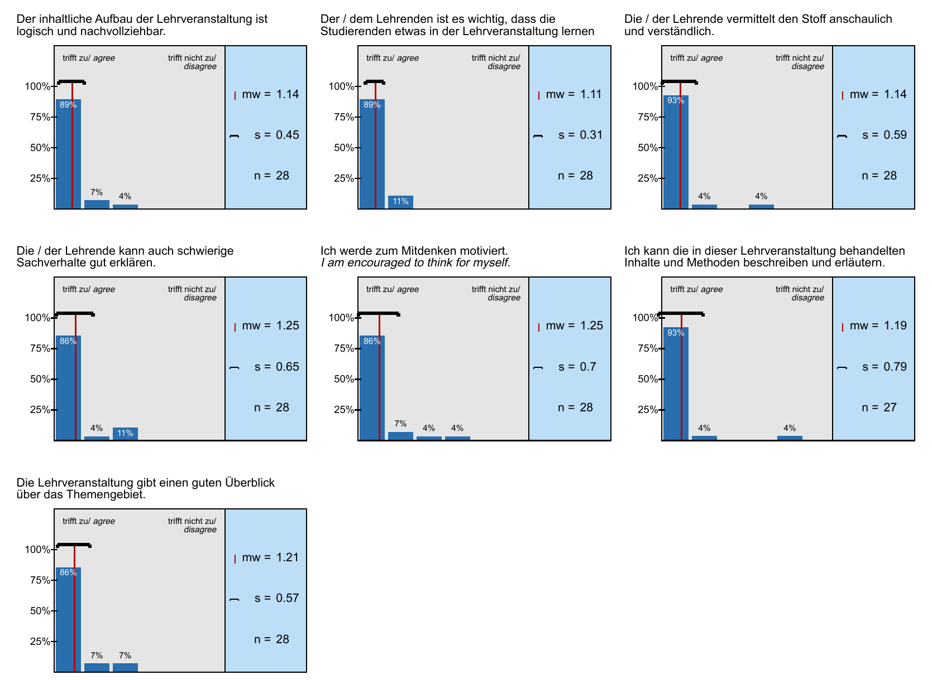
Course Evaluation Results
Feedback

Slide 5
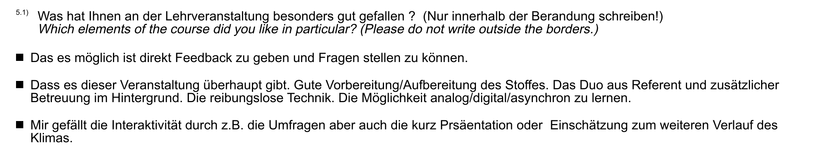
Course Evaluation Results
Feedback

Slide 6
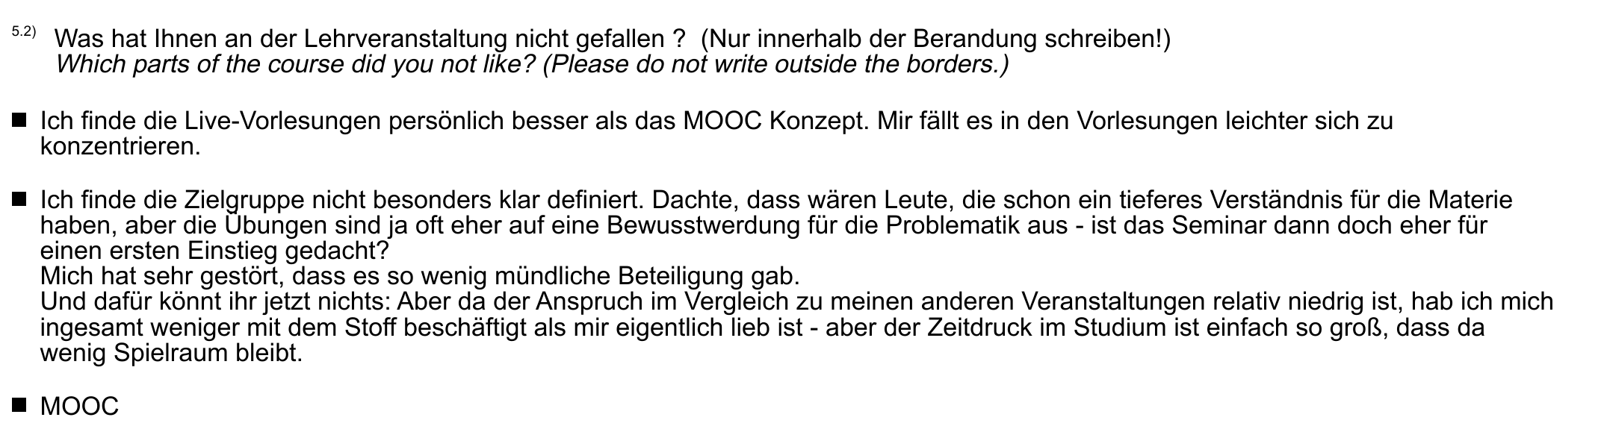
Course Evaluation Results
Feedback

Slide 7
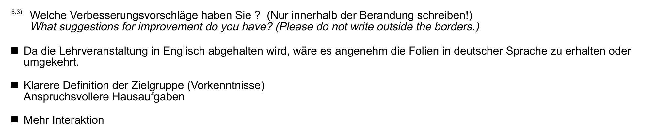
Course Evaluation Results
Feedback

Slide 8
Recap – LTG Course in a nutshell

Slide 9
LTG Recap
Sustainability – Definition

Slide 10
LTG Recap
Sustainability – Definition
„Development that meets the needs of the present without compromising the ability of future generations to meet their own needs.”
Report of the World Commission on Environment and Development: Our Common Future (1987) – http://www.un-documents.net/our-common-future.pdf

Slide 11
LTG Recap
Sustainability – Implication
Sustainability → Consume less

Slide 12

LTG Recap
Climate Change – Global GHG Emission Pathways (2019)
Hannah Ritchie and Max Roser, adapted for svg and smartphone by Eric Fisk – https://commons.wikimedia.org/wiki/File:Greenhouse_gas_emission_scenarios_01.svg – CC BY-SA 4.0.

Slide 13
LTG Recap
Climate Change – 1.5°C vs. 2/3/4°C
“If we can keep warming below 3°C we likely remain within our adaptive capacity as a civilization, but at 2.7°C warming we would experience great hardship.” - Prof. Michael Mann

Slide 14
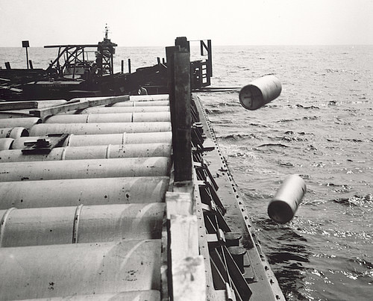
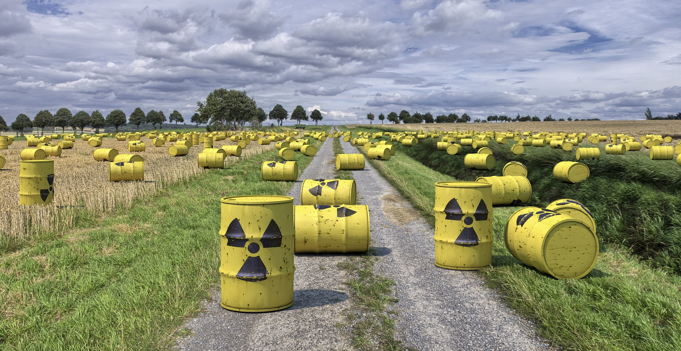
LTG Recap
Environmental Pollution – Horrible Waste Management
"Nuclear waste" by aaadrian365 is licensed with CC BY-NC 2.0. To view a copy of this license, visit https://creativecommons.org/licenses/by-nc/2.0/

Slide 15
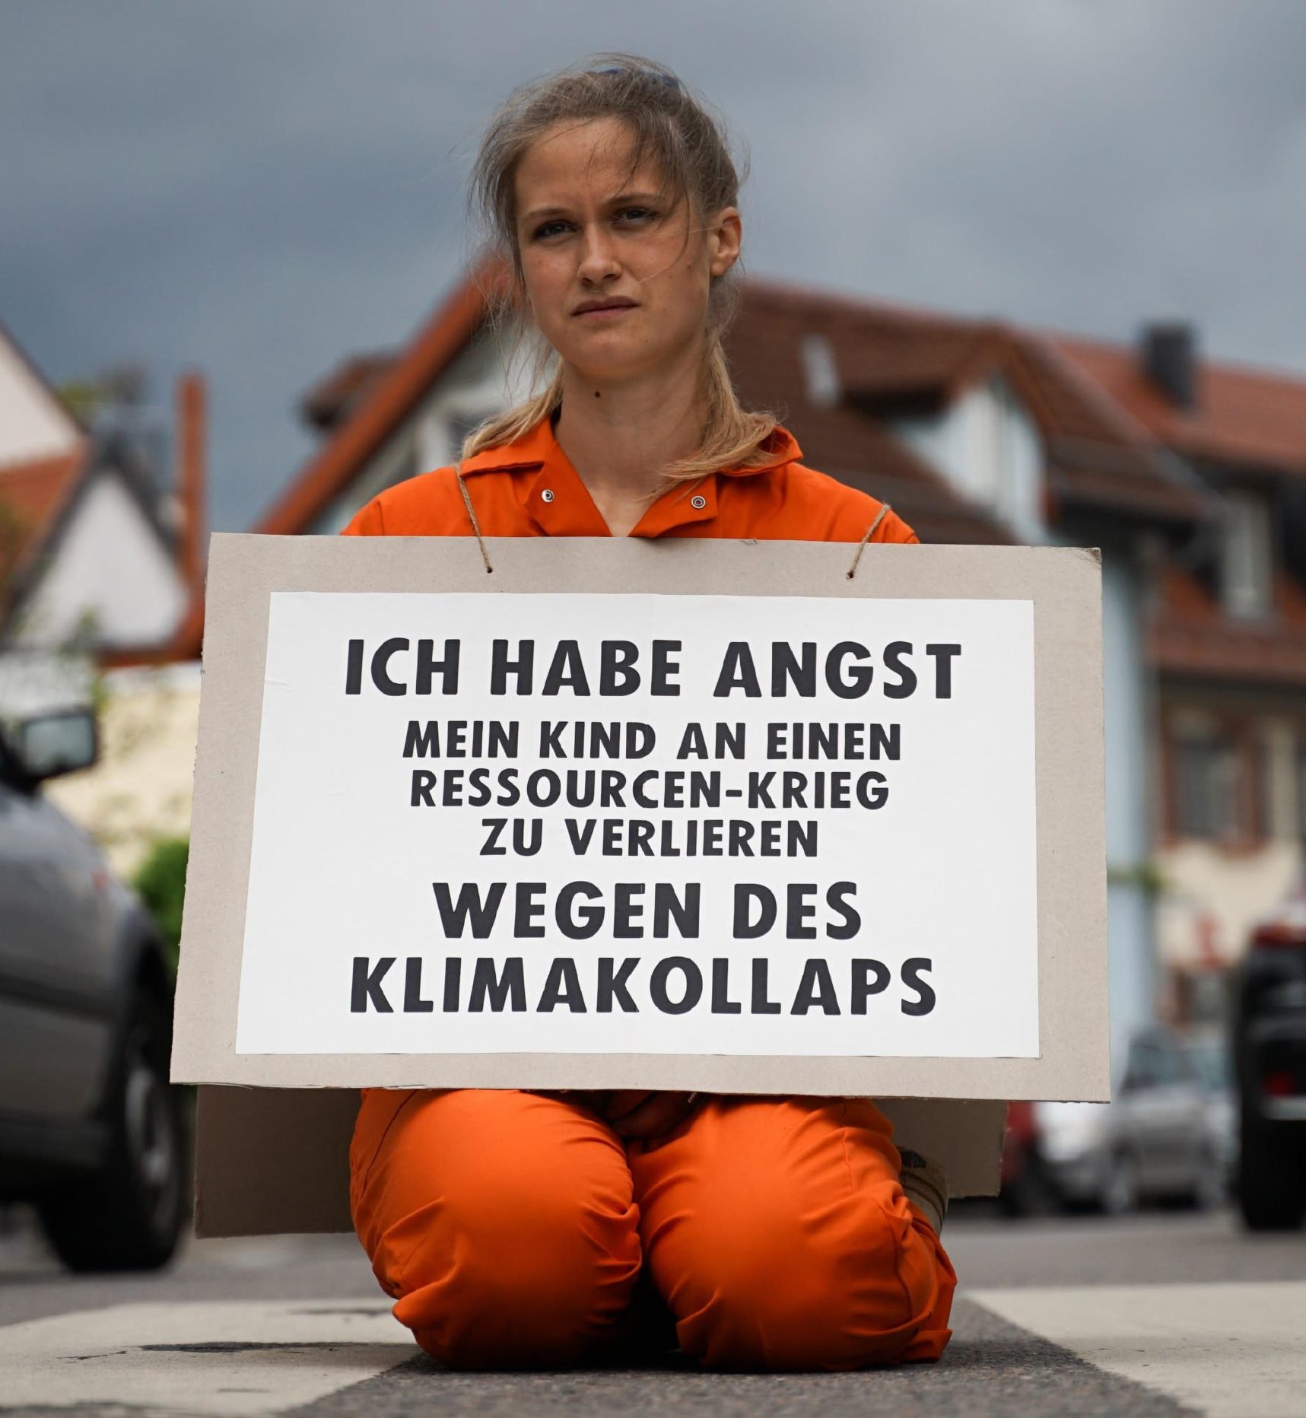
LTG Recap
Dwindling (Non-)Renewable Resources
“I am afraid of losing my child to a resource war because of a climate collapse”
→ “Our parents will die of old age, our children will die of climate change”
XR Strategiepapier 2022 – Pusteblumen und Hype. Bilder: Sebastian Höhn, Joe Pohl, Sandra Doneck, Alessandro Brönnimann

Slide 16
LTG Recap
3 Key Challenges of the 21st Century
Climate change / adaption to climate change
Environmental pollution
Dwindling non-renewable resources

Slide 17
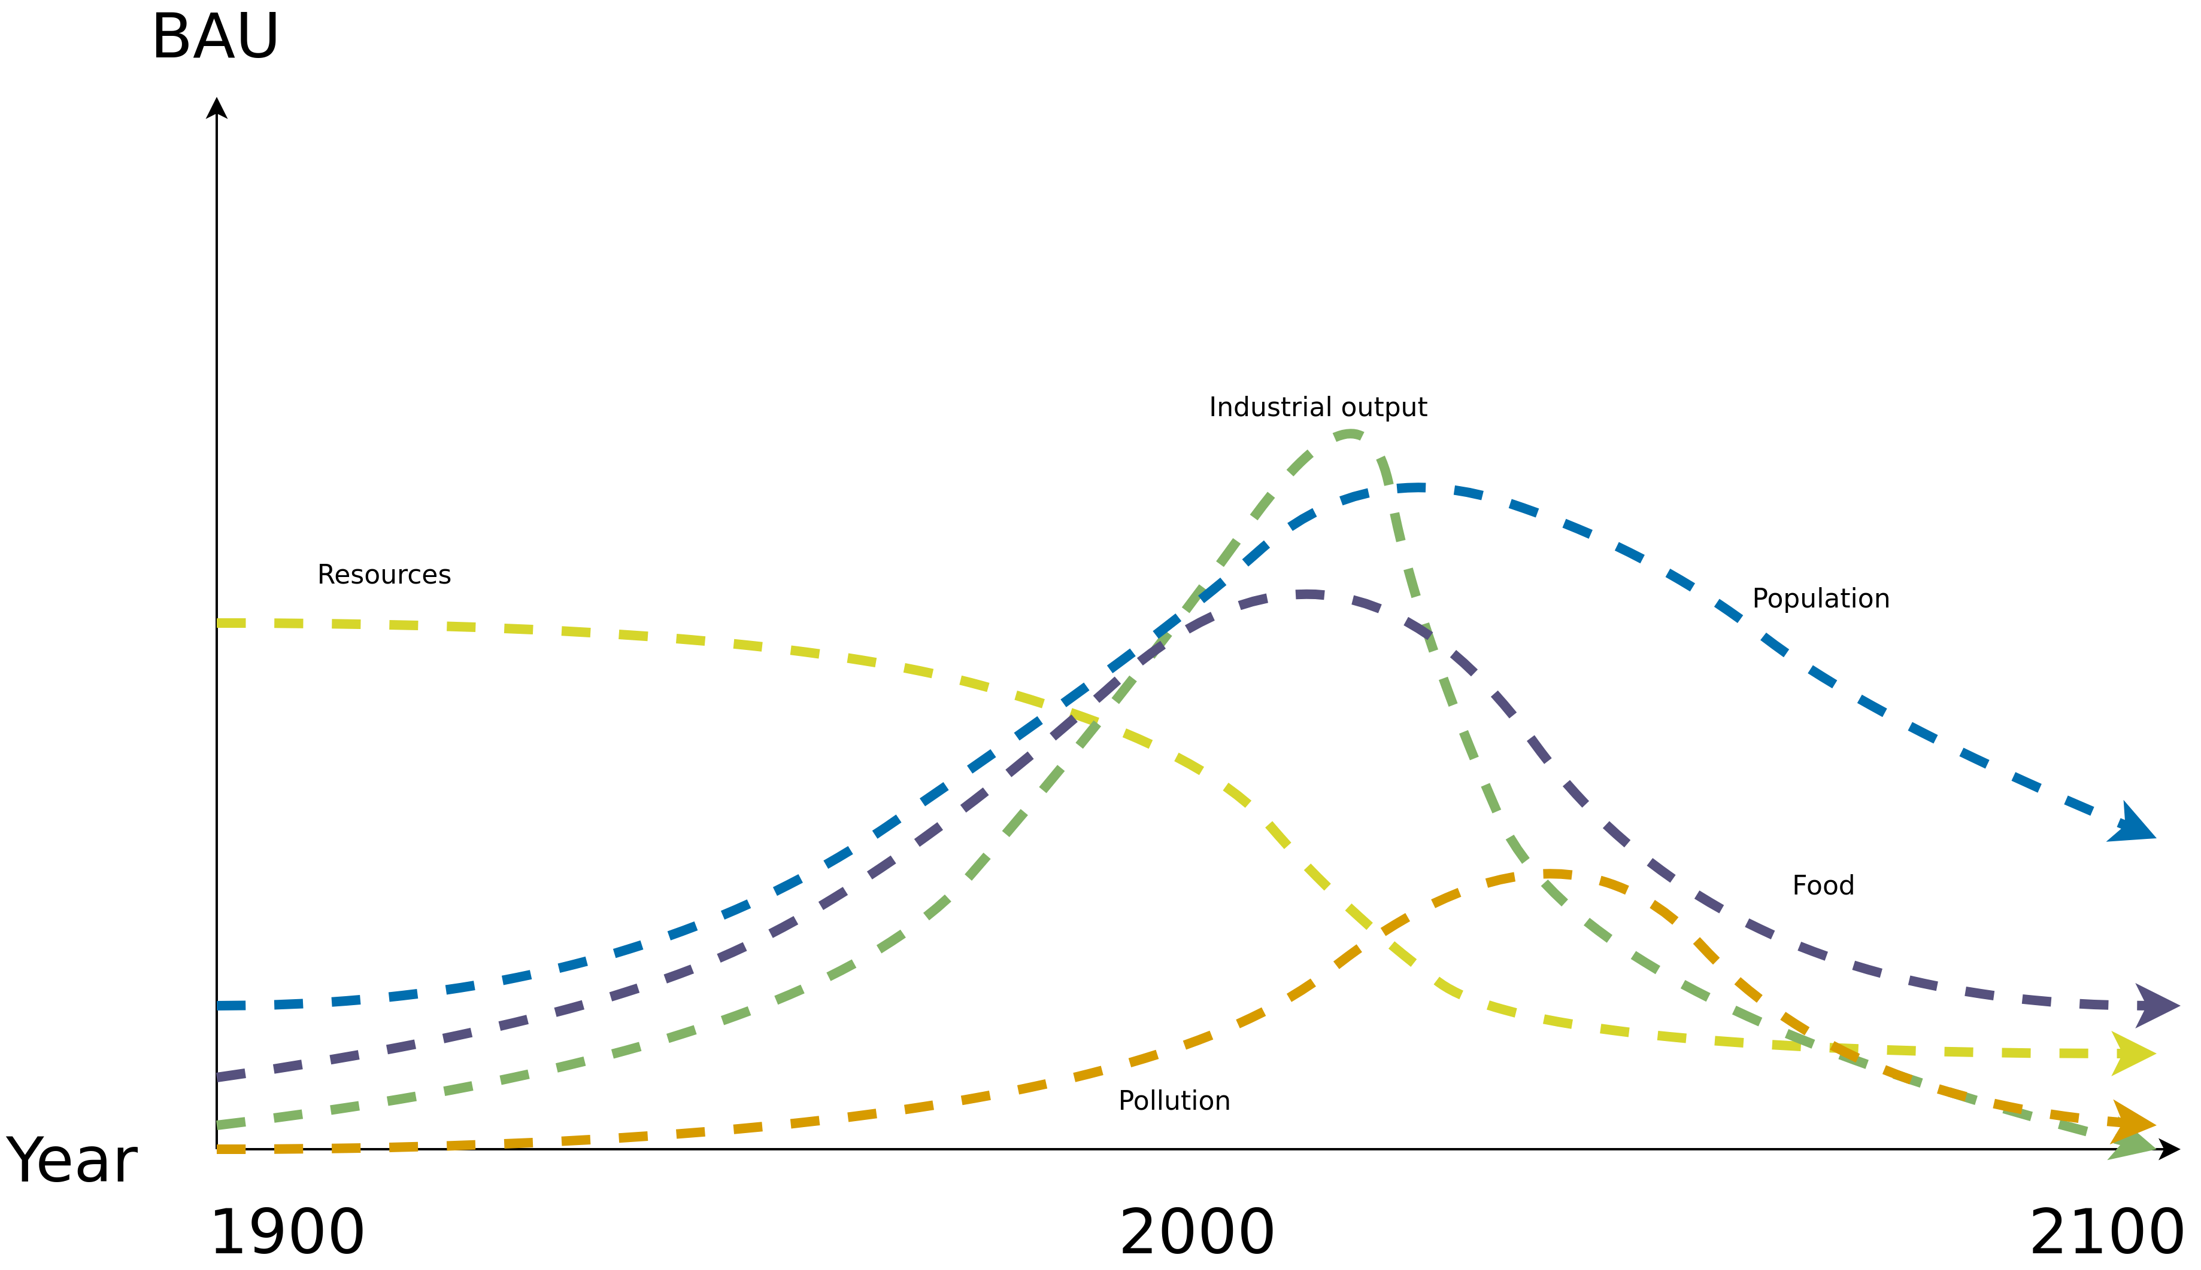
LTG Recap
World3 Standard Run – Business-as-Usual (BAU)
Image recreated from: Gaya Herrington (2020) – Update to limits to growth: Comparing the World3 model with empirical data – Link

Slide 18
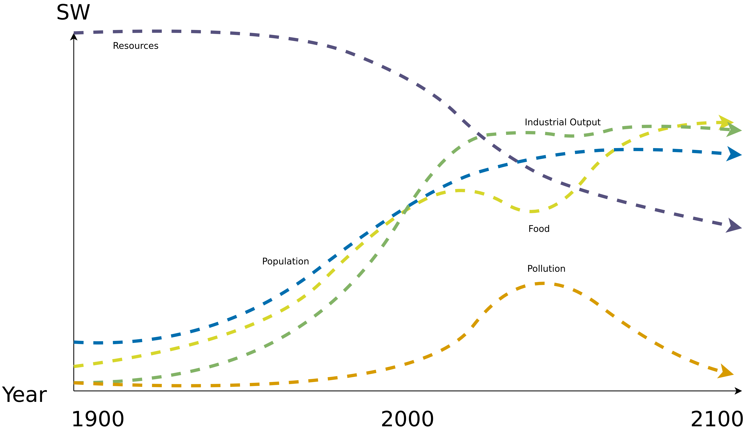
LTG Recap
World3 – Stabilized World (SW)
→ Population stabilizes in the twenty-first century, as does human welfare on a high level
Image recreated from: Gaya Herrington (2020) – Update to limits to growth: Comparing the World3 model with empirical data – Link

Slide 19
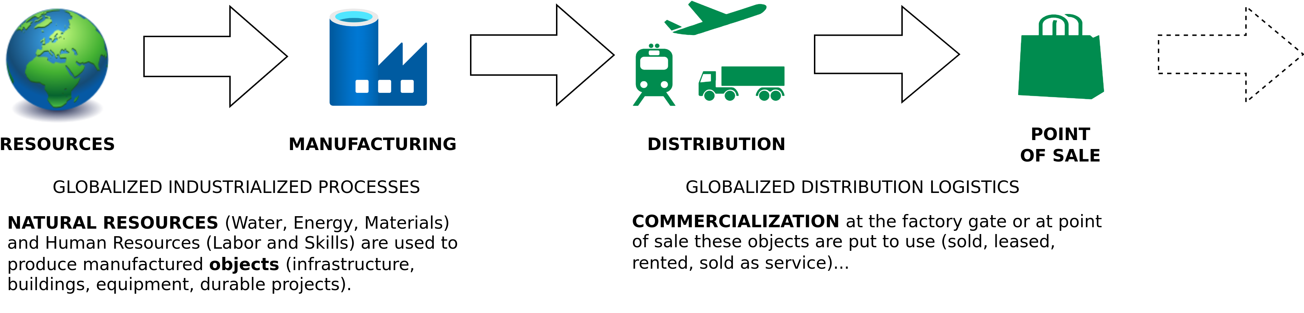
LTG Recap
Linear (Industrial) Economy
Image adapted from: Walter R. Stahel (2019) – The Circular Economy: A User’s Guide.

Slide 20
LTG Recap
Circular Economy
Center for Digital Technologies (DIGIT) (2022) – https://www.digit-research.de/fileadmin/DIGIT/Presse_und_News/Downloads/Grafikpaket_Reallabor_DCE_Kreislaufmodell_V2_ccby.zip – CC BY 4.0.

Slide 21

LTG Recap
Performance Economy – Definition
Image adapted from Walter R. Stahel (2019) – The Circular Economy: A User’s Guide.

Slide 22
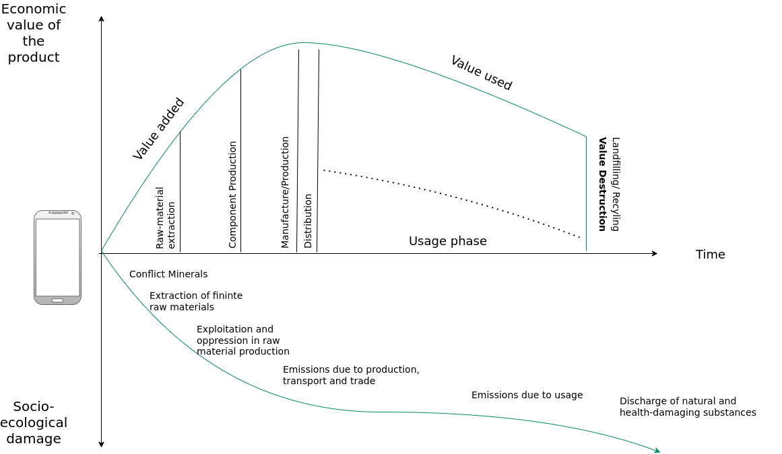
LTG Recap
Circular Society – CE Criticism
Image adapted from: M. Jaeger-Erben, F. Hofmann (2019) – Kreislaufwirtschaft - Ein Ausweg aus der sozial-ökologischen Krise? – Link.

Slide 23
LTG Recap
Circular Society – CE Criticism
Replace the LE with circularly oriented forms of consumption and production
CE focus mostly on earned value management (“Wertschöpfungsmanagement”), product-service systems, product/business model innovations within existing power asymmetries
Decouple economic growth and consumption of natural resources
→ But why do we need never ending economic growth and why is it good to consume as many goods and services as possible?
Alternatives:
Sufficiency strategies and lifestyle changes
Question the prevailing entrepreneurial orientation towards the shareholder concept
Deconstruction of existing power and hegemonic relations
Partially based on: F. Hofmann, J. Zwiers (2018) – Circular Society – Eine pluralistische und emanzipatorische Alternative zur Circular Economy? – Link.
.

Slide 24
LTG Recap
Circular Society – CE Criticism
Replace the LE with circularly oriented forms of consumption and production
CE focus mostly on earned value management (“Wertschöpfungsmanagement”), product-service systems, product/business model innovations within existing power asymmetries
Decouple economic growth and consumption of natural resources
→ But why do we need never ending economic growth and why is it good to consume as many goods and services as possible?
Alternatives:
Sufficiency strategies and lifestyle changes
Question the prevailing entrepreneurial orientation towards the shareholder concept
Deconstruction of existing power and hegemonic relations
Partially based on: F. Hofmann, J. Zwiers (2018) – Circular Society – Eine pluralistische und emanzipatorische Alternative zur Circular Economy? – Link.
.

Slide 25
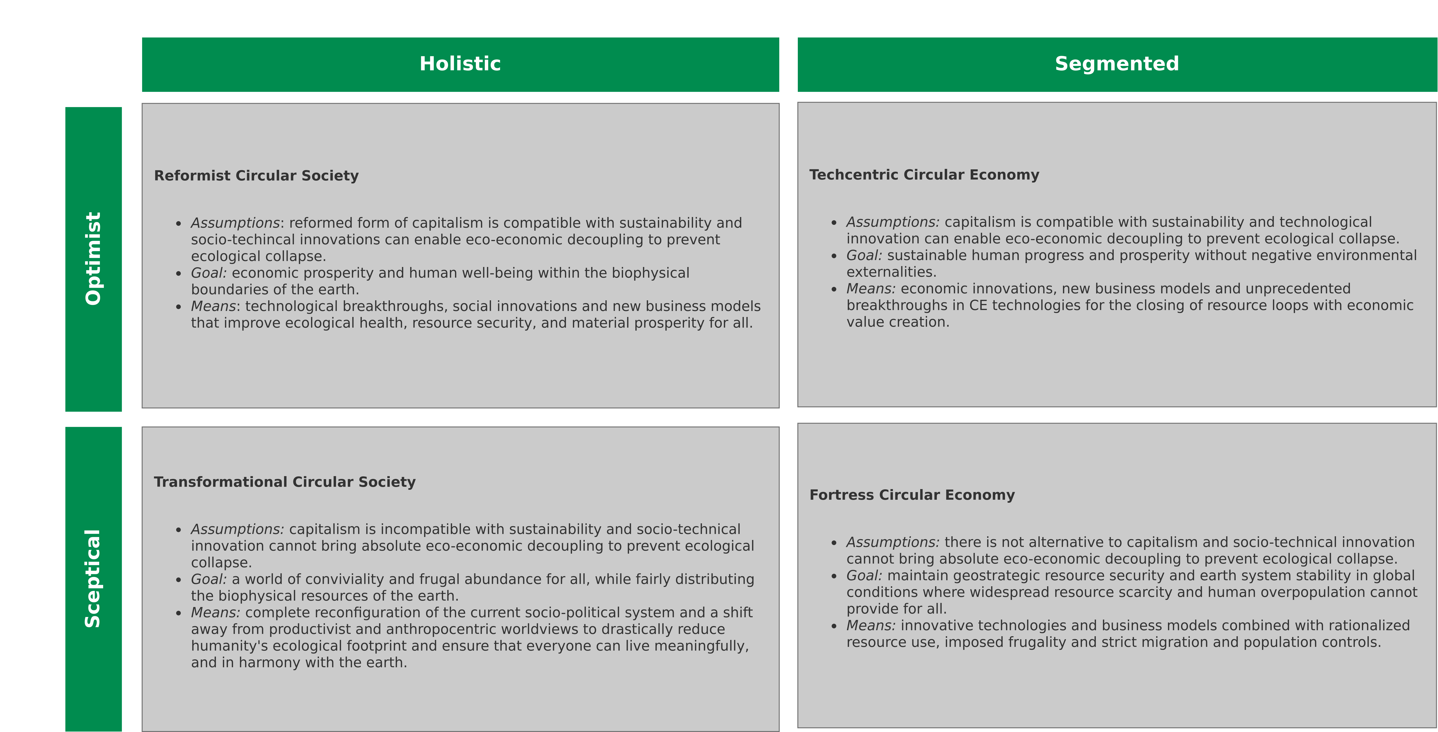
LTG Recap
CS and CE Perspectives
Image recreated from: M. C. Friant, R. Salomone, W. J. V. Vermeulen (2020) – A Typology of Circular Economy Discourses: Navigating the Diverse Visions of a Contested Paradigm – Link

Slide 26
LTG Recap
Eco-Sufficiency – Definition(s)
“Seeking enough when more is possible is both intuitive and rational - personally, organizationally and ecologically. And under global ecological constraint, it is ethical.” - Thomas Princen
“A set of policy measures and daily practices that avoid the demand for energy, materials, land, water, and other natural resources while providing wellbeing for all within the planetary boundaries.” - IPCC
Thomas Princen (2005) – The Logic of Sufficiency
IPCC AR6 Synthesis Report: Climate Change 2023 – https://www.ipcc.ch/report/sixth-assessment-report-cycle/

Slide 27
LTG Recap
Eco-Sufficiency – Definition(s)
“Seeking enough when more is possible is both intuitive and rational - personally, organizationally and ecologically. And under global ecological constraint, it is ethical.” - Thomas Princen
“A set of policy measures and daily practices that avoid the demand for energy, materials, land, water, and other natural resources while providing wellbeing for all within the planetary boundaries.” - IPCC
Sufficiency → All you need is less
Thomas Princen (2005) – The Logic of Sufficiency
IPCC AR6 Synthesis Report: Climate Change 2023 – https://www.ipcc.ch/report/sixth-assessment-report-cycle/

Slide 28
LTG Recap
Universal Basic Income – Definition(s)
“A transfer that is provided universally, unconditionally, and in cash” – World Bank
“A Basic Income is a periodic cash payment unconditionally delivered to all on an individual basis, without means-test or work requirement.” - Basic Income Earth Network
Periodic → Paid at regular intervals
Cash payment → Paid in an appropriate medium of exchange
Individual → Paid on an individual basis (e.g., not to households)
Universal → Paid to everyone
Unconditional → Paid without means test and without a requirement to work or to demonstrate willingness-to-work
1.) The World Bank (2020) – Exploring Universal Basic Income : A Guide to Navigating Concepts, Evidence, and Practices - Link
2.) BIEN (Basic Income Earth Network) – https://basicincome.org/about-basic-income

Slide 29
Now What?

Slide 30
Now What? → It’s time to Act

Slide 31
Act Now
Courage
“But the opposite of hope is not despair. It is grief. Even while resolving to limit the damage, we can mourn. And here, the sheer scale of the problem provides a perverse comfort: we are in this together. The swiftness of the change, its scale and inevitability, binds us into one, broken hearts trapped together under a warming atmosphere.
We need courage, not hope. Grief, after all, is the cost of being alive. [...] Courage is the resolve to do well without the assurance of a happy ending.”
Kate Marvel (2018) – We Need Courage, Not Hope, to Face Climate Change – https://onbeing.org/blog/kate-marvel-we-need-courage-not-hope-to-face-climate-change/

Slide 32
Act Now
Image recreated from: M. C. Friant, R. Salomone, W. J. V. Vermeulen (2020) – A Typology of Circular Economy Discourses: Navigating the Diverse Visions of a Contested Paradigm – Link

Slide 33
Act Now
Minimize/Avoid Waste – Waste Is A Human Concept
Waste = Inefficiency

Slide 34
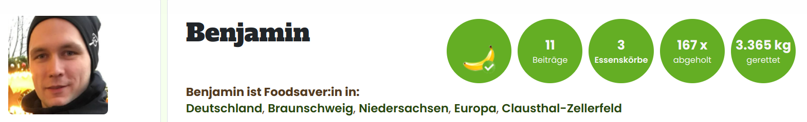
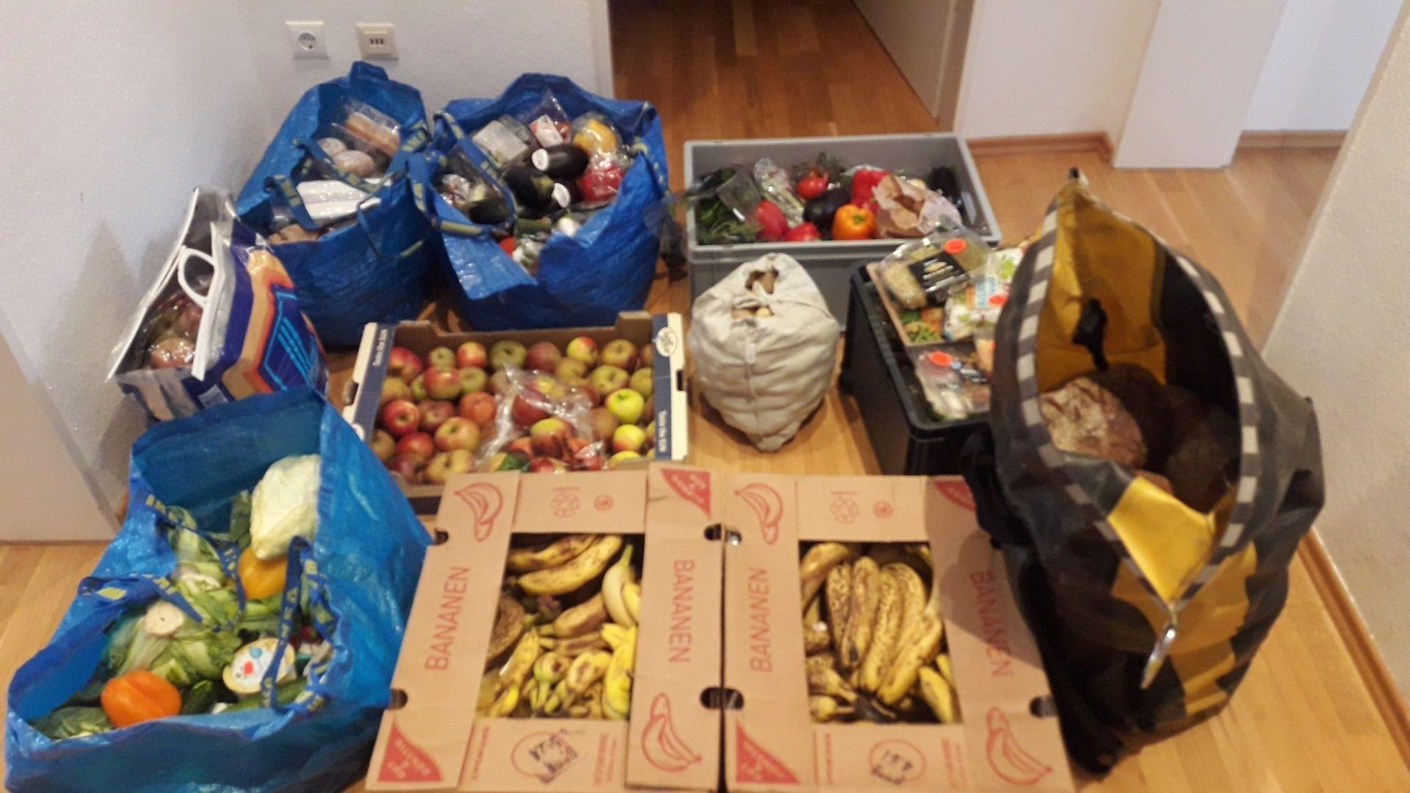
Act Now
Minimize/Avoid Waste – Foodsharing
https://foodsharing.de/

Slide 35
Act Now
Minimize/Avoid Waste – General
Taking responsibility (being accountable) for the trash/waste that you create and the resources that you consume
What is left after you have consumed the product/service?
Does it generate, or result in trash/waste?
Can you reuse it in any other way, thereby avoiding trash?
Is the generated waste, the implicit/explicit environmental pollution, the used resources, and so on, worth the short term pleasure?
Zero-waste might be unrealistic
Instead → Reduce your footprint (not only carbon) as much as possible
Resources, energy, pollution, emissions, etc.
Act before it is to late

Slide 36
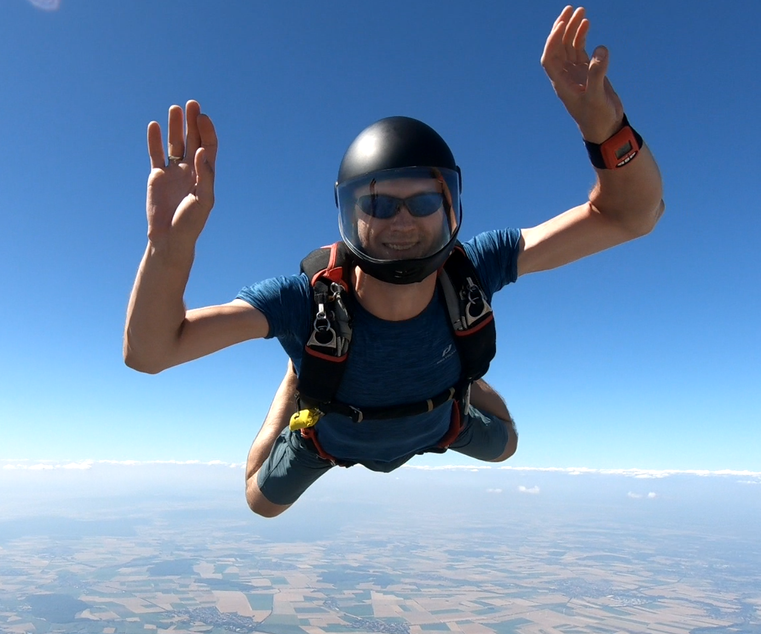
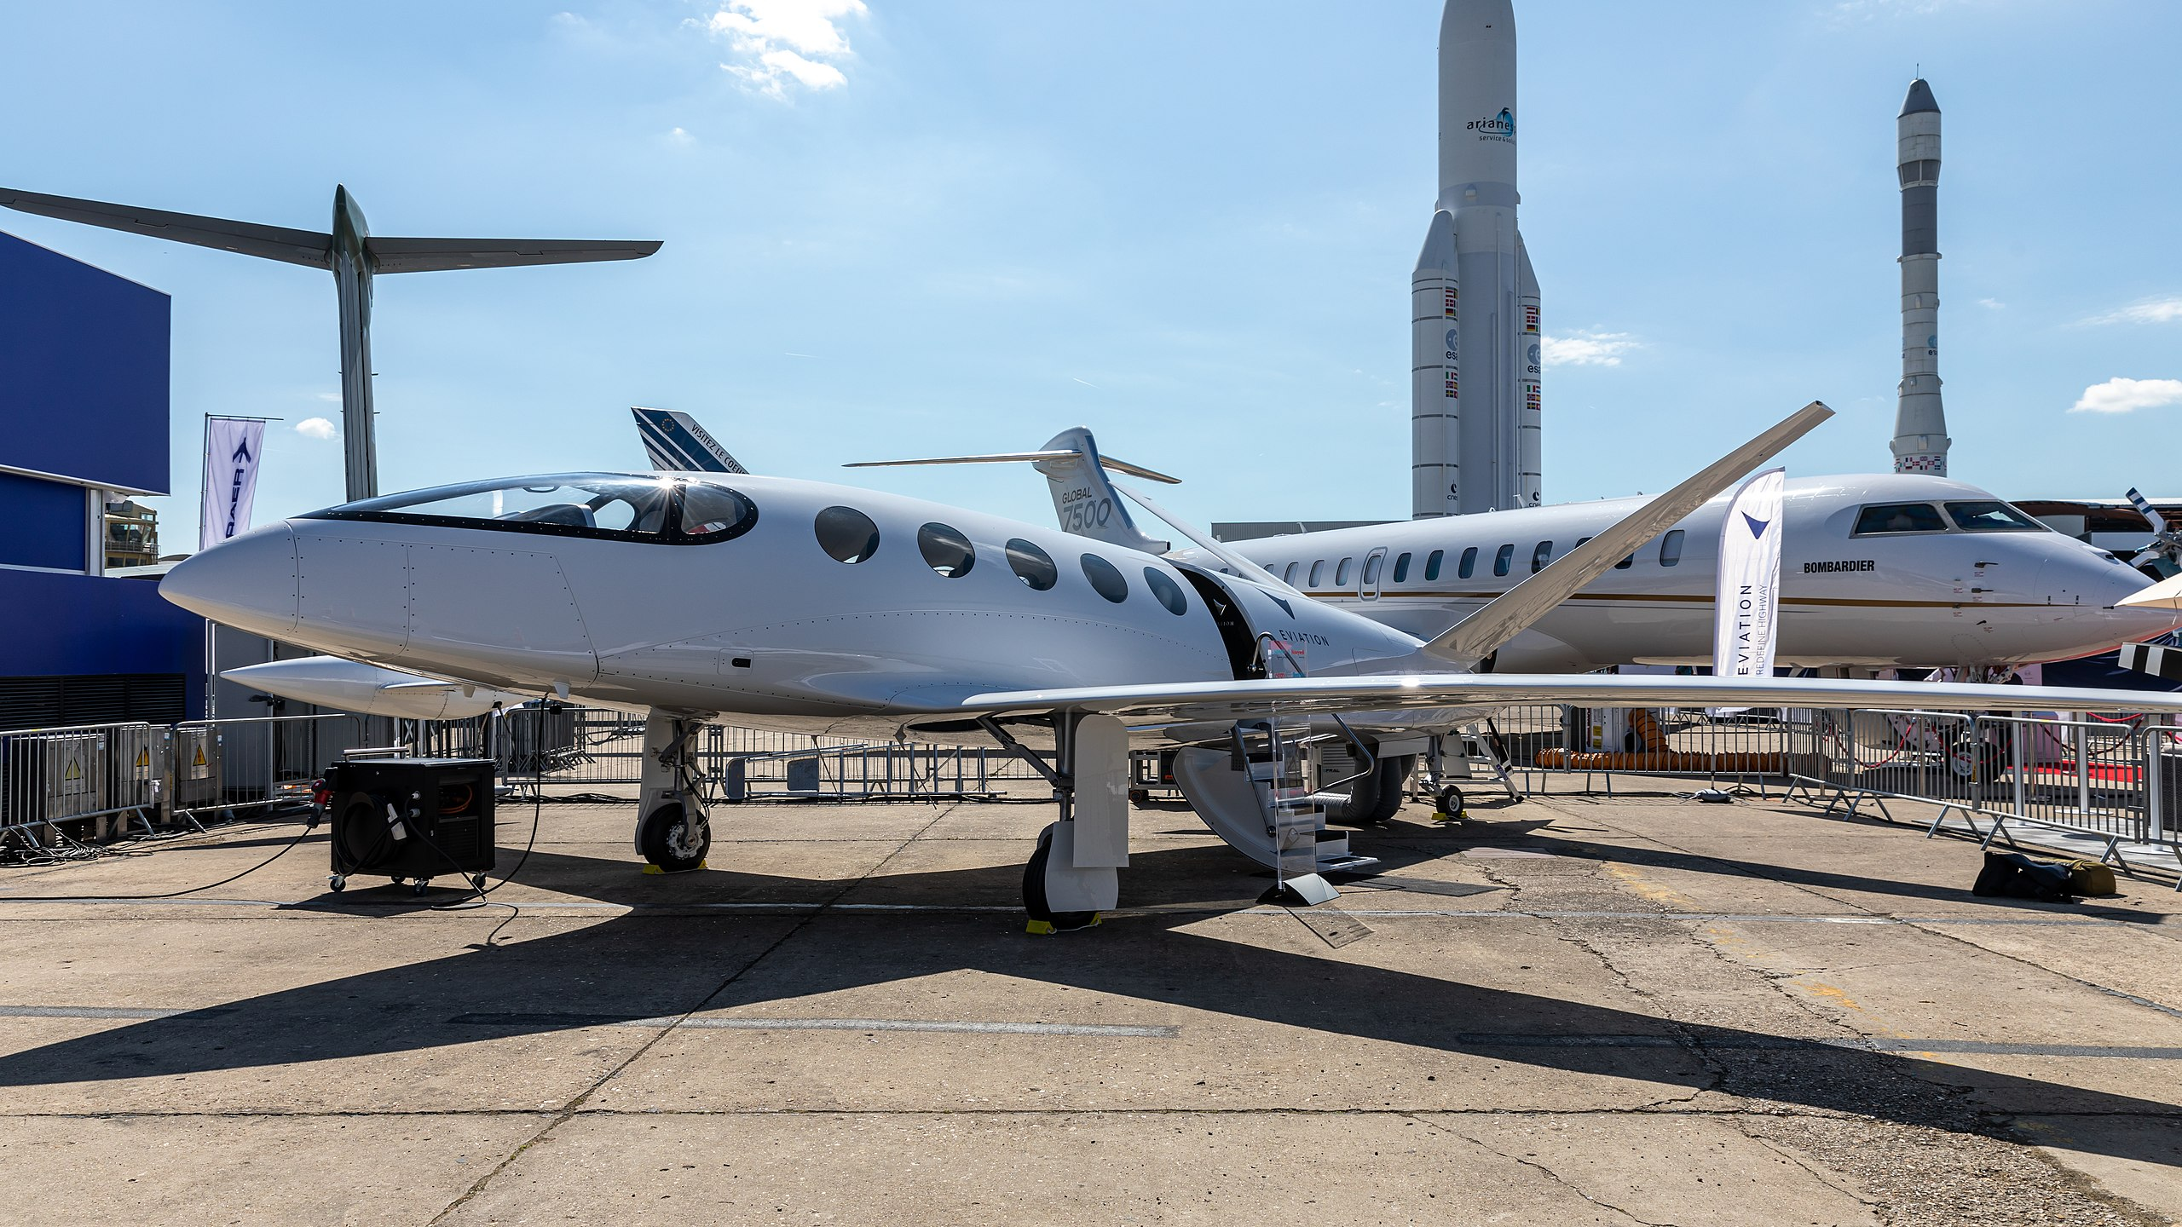

Act Now
Act Sustainable
1.Matti Blume – https://upload.wikimedia.org/wikipedia/commons/b/ba/Eviation_Alice%2C_Paris_Air_Show_2019%2C_Le_Bourget_%28SIAE8856%29.jpg – CC BY-SA 4.0
2.Benjamin Leiding – CC BY-SA 4.0.

Slide 37
Act Now
Act Sustainable
1.Matti Blume – https://upload.wikimedia.org/wikipedia/commons/b/ba/Eviation_Alice%2C_Paris_Air_Show_2019%2C_Le_Bourget_%28SIAE8856%29.jpg – CC BY-SA 4.0
2.Benjamin Leiding – CC BY-SA 4.0.

Slide 38
Act Now
Minimize Your Footprint – Sustainability
Sustainability → Consume less

Slide 39
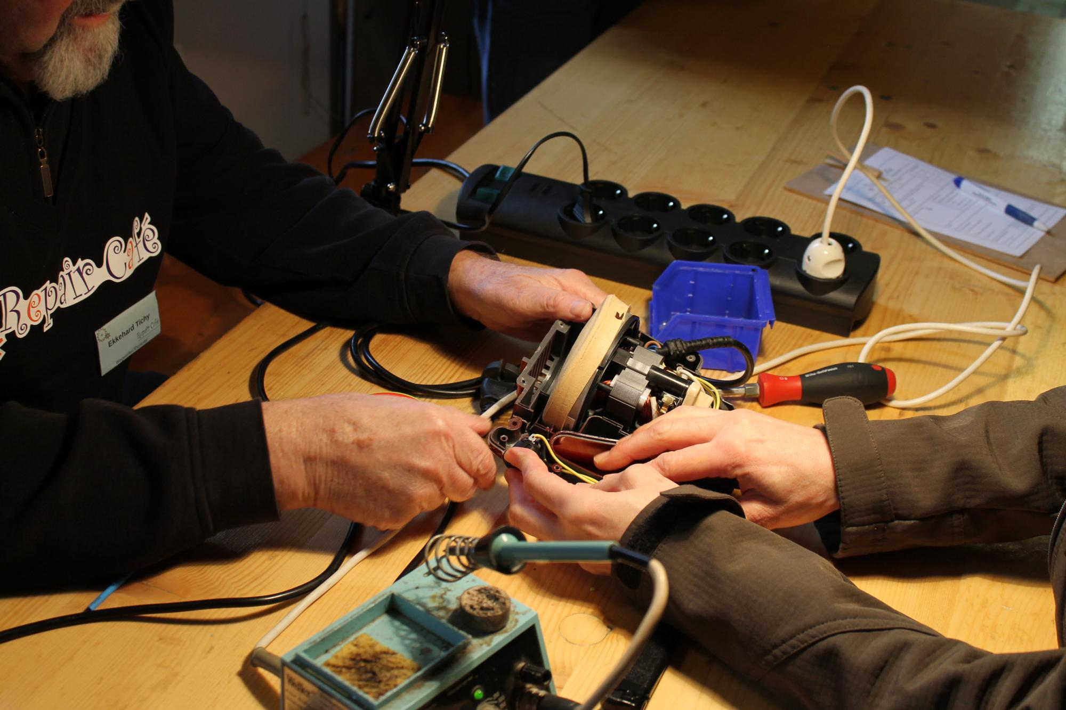
Act Now
Minimize Your Footprint – Repair Cafe / Sharing / 2nd Hand
1. RaMa2016 – https://upload.wikimedia.org/wikipedia/commons/1/17/Repair_Caf%C3%A9_Trier_Reparatur.jpg – CC BY-SA 4.0
2. Ibrahim Husain Meraj – https://upload.wikimedia.org/wikipedia/commons/9/96/Various_tools_for_cycle_repair_01.jpg – CC BY-SA 4.0
3. Janne Hellsten – https://upload.wikimedia.org/wikipedia/commons/e/e3/Brand_new_second_hand.jpg – CC BY 2.0

Slide 40
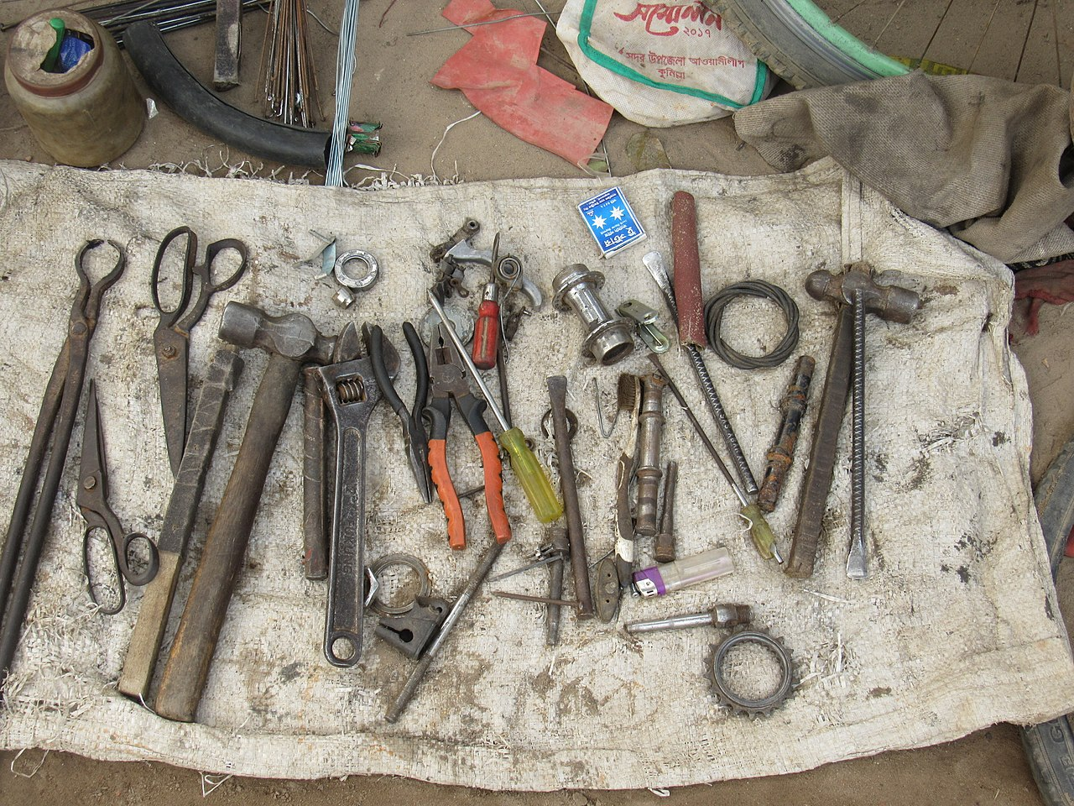
Act Now
Minimize Your Footprint – Repair Cafe / Sharing / 2nd Hand
1. RaMa2016 – https://upload.wikimedia.org/wikipedia/commons/1/17/Repair_Caf%C3%A9_Trier_Reparatur.jpg – CC BY-SA 4.0
2. Ibrahim Husain Meraj – https://upload.wikimedia.org/wikipedia/commons/9/96/Various_tools_for_cycle_repair_01.jpg – CC BY-SA 4.0
3. Janne Hellsten – https://upload.wikimedia.org/wikipedia/commons/e/e3/Brand_new_second_hand.jpg – CC BY 2.0

Slide 41
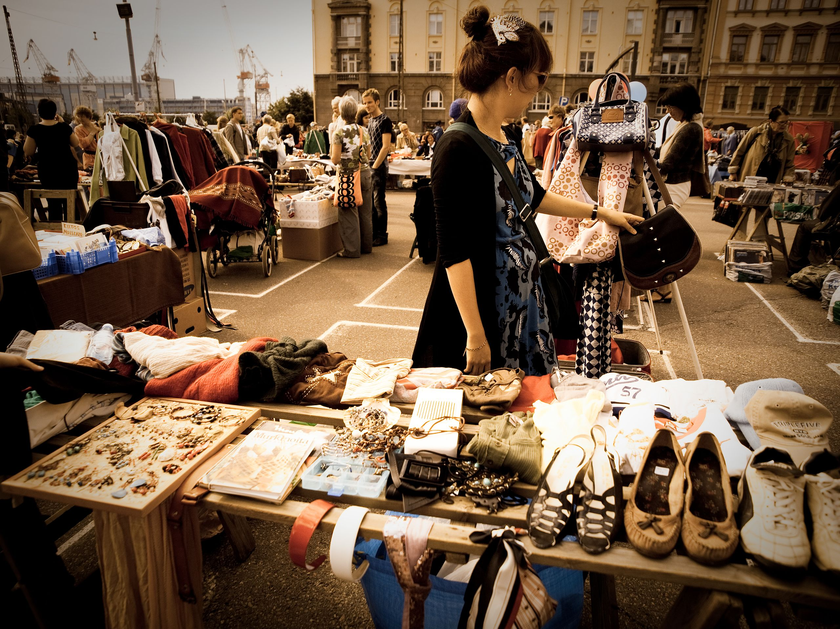
Act Now
Minimize Your Footprint – Repair Cafe / Sharing / 2nd Hand
1. RaMa2016 – https://upload.wikimedia.org/wikipedia/commons/1/17/Repair_Caf%C3%A9_Trier_Reparatur.jpg – CC BY-SA 4.0
2. Ibrahim Husain Meraj – https://upload.wikimedia.org/wikipedia/commons/9/96/Various_tools_for_cycle_repair_01.jpg – CC BY-SA 4.0
3. Janne Hellsten – https://upload.wikimedia.org/wikipedia/commons/e/e3/Brand_new_second_hand.jpg – CC BY 2.0

Slide 42
Act Now
Climate-Resilient Food Production
Agroforestry → Trees/shrubs are grown around or among crops or pastureland (Link)
Permaculture → Growth of an agricultural ecosystem in a self-sufficient and sustainable way (Link)
Silvopasture → Trees, forage and domesticated animals in a mutually beneficial way
Etc.

Slide 43
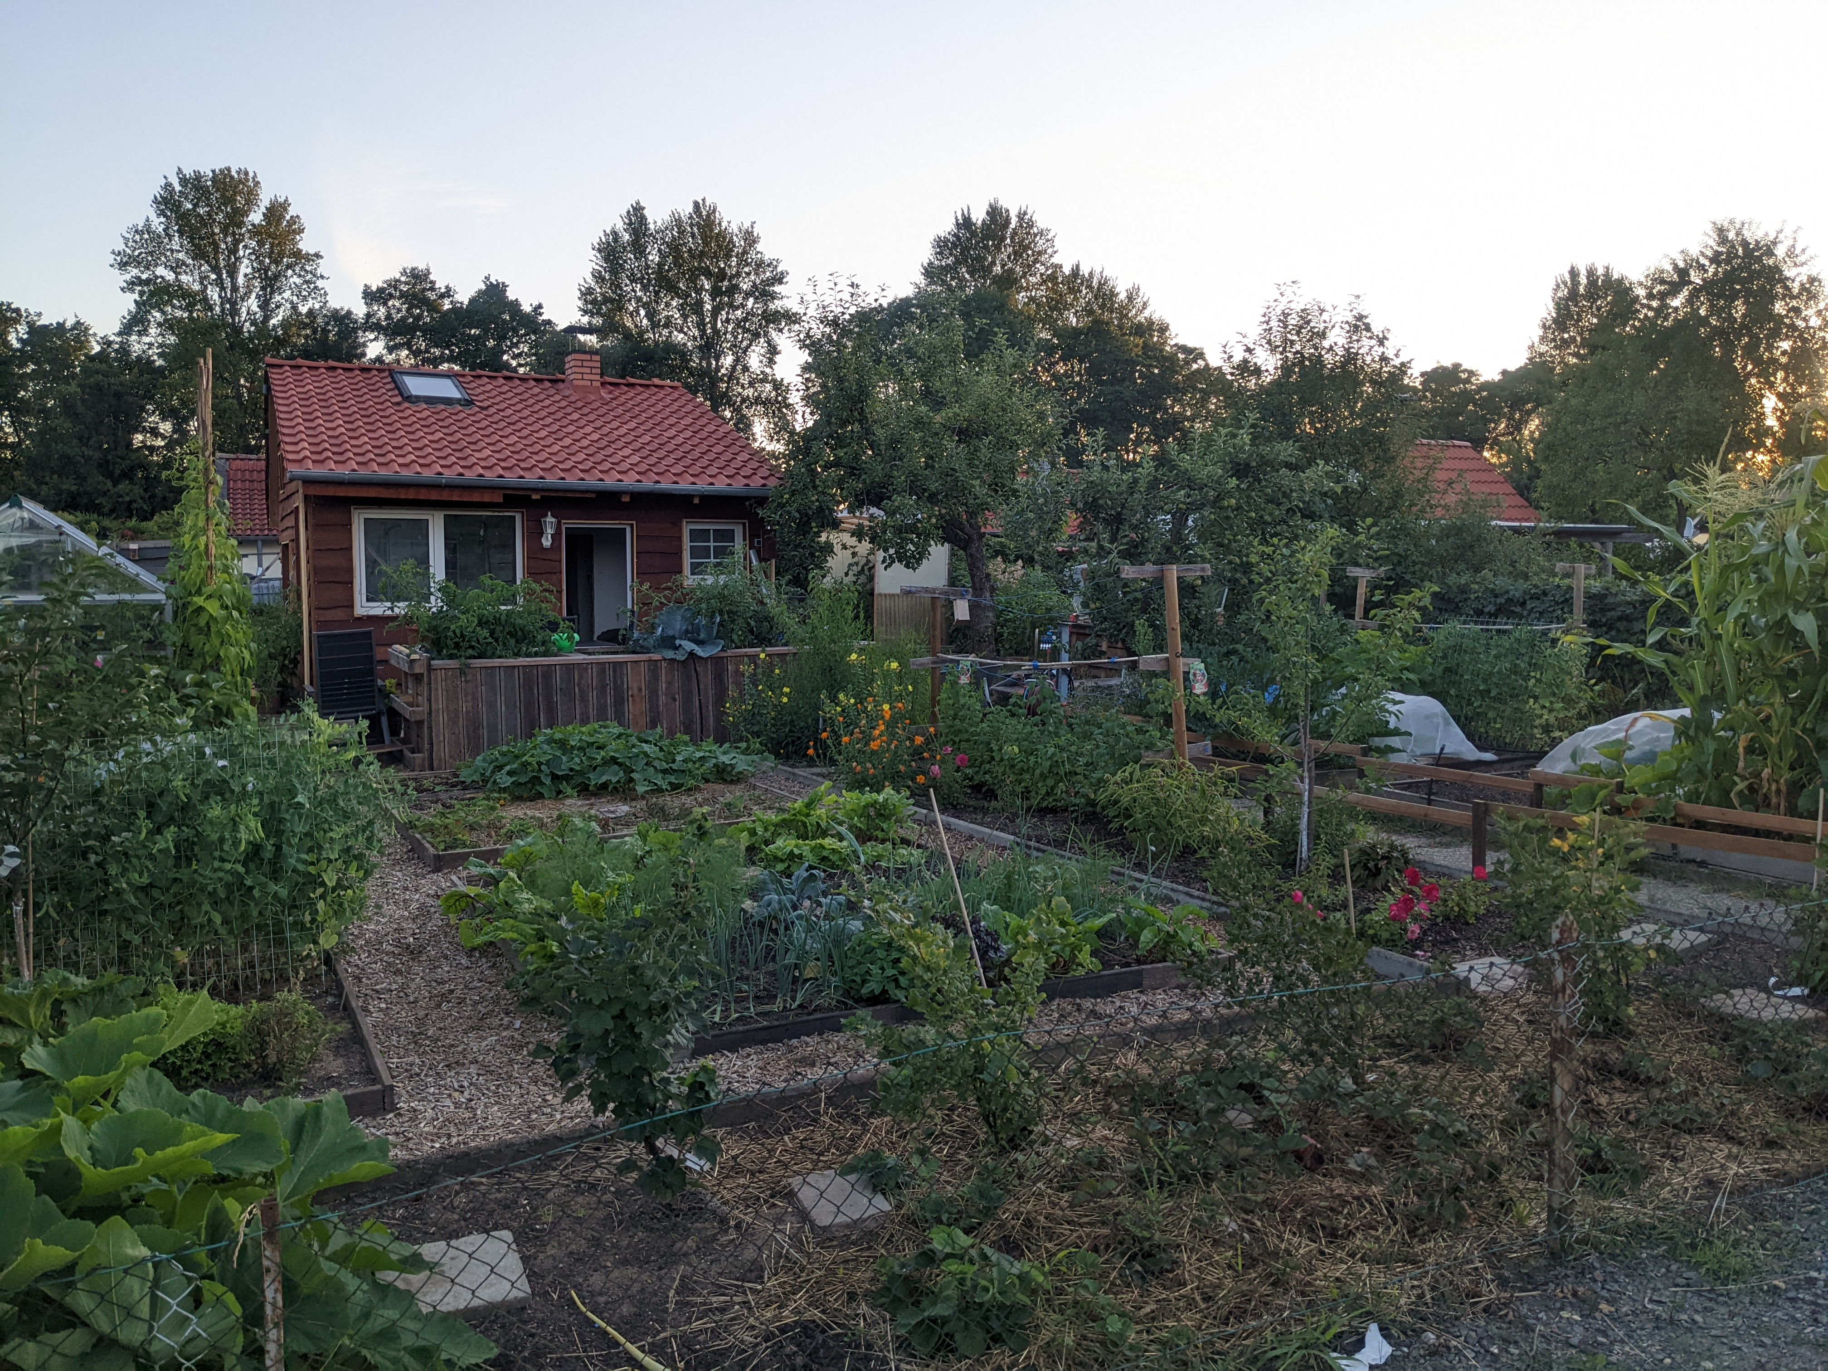
Act Now
Climate-Resilient Food Production – Garden Plot (“Kleingarten”)
Benjamin Leiding – CC BY-SA 4.0.

Slide 44
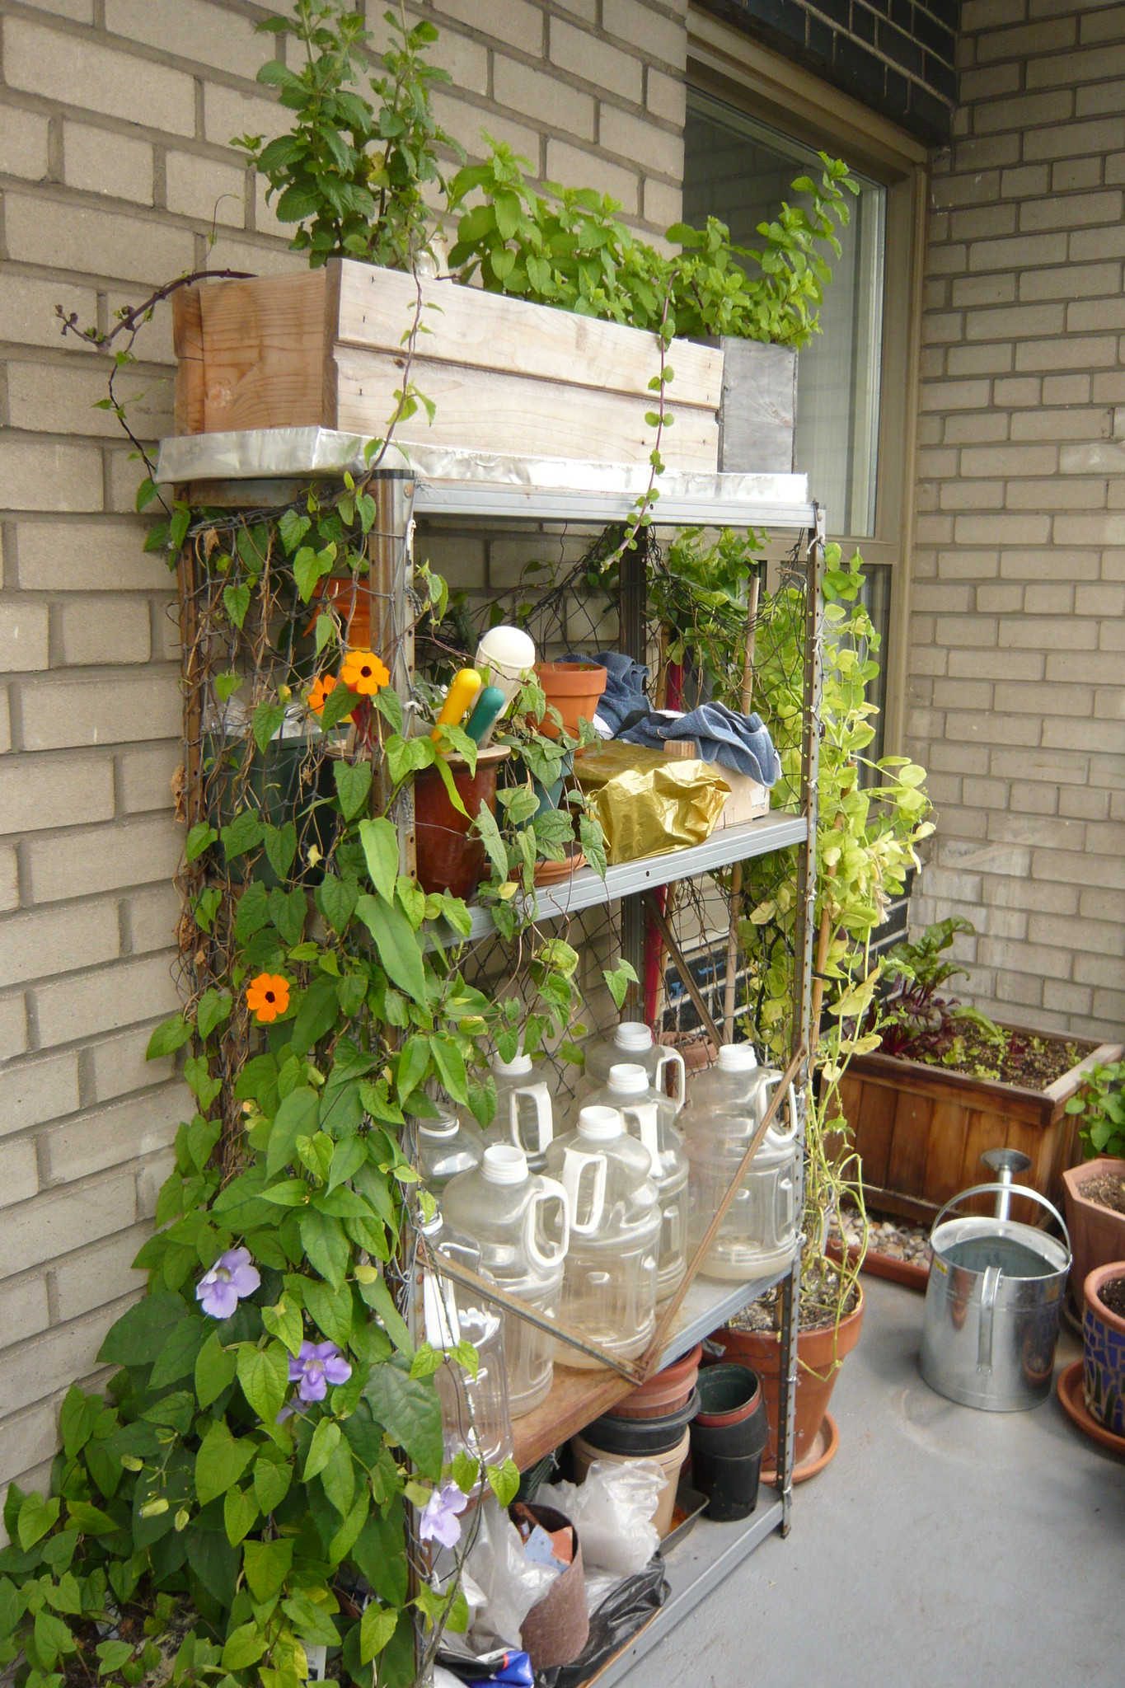
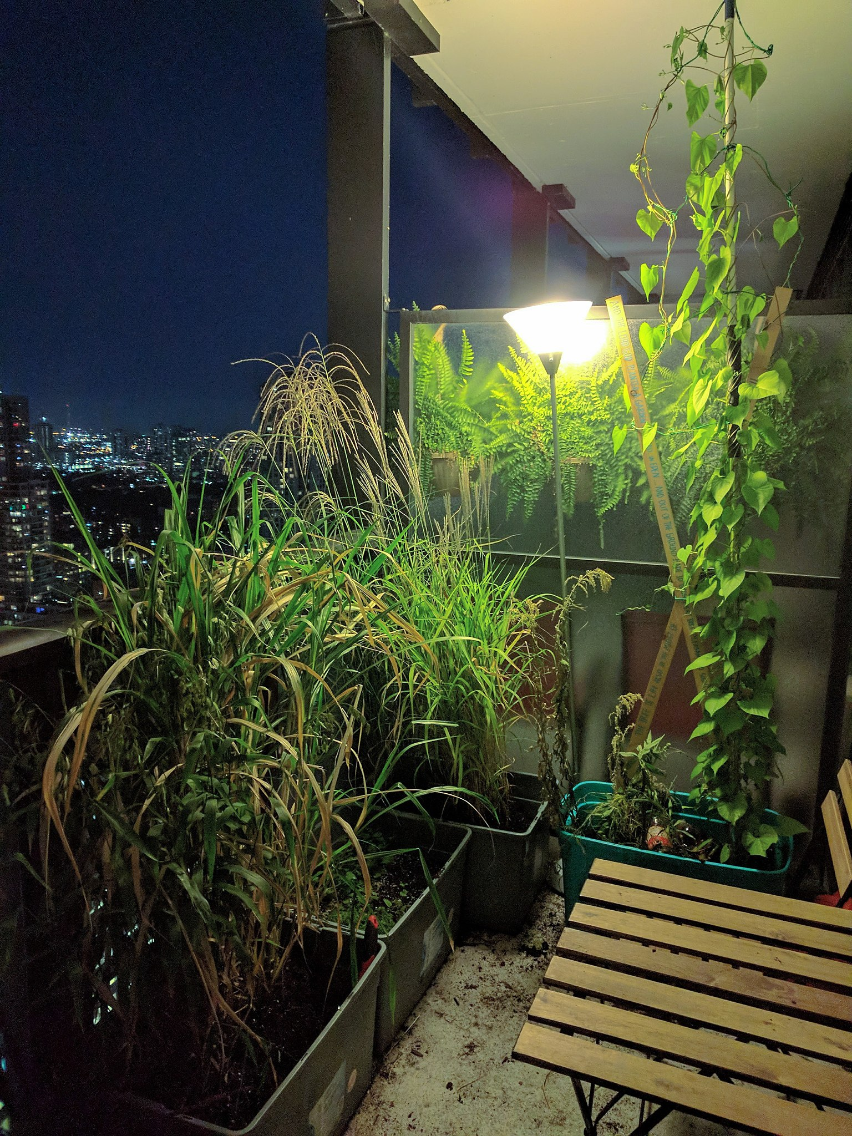
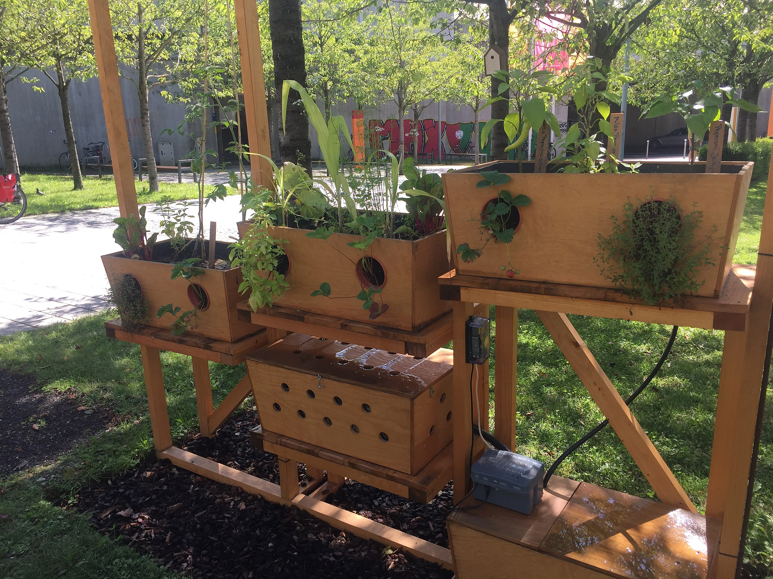
Act Now
Climate-Resilient Food Production – Urban/Balcony Gardening
1. Neitram – https://upload.wikimedia.org/wikipedia/commons/7/71/Urban-Gardening-Demonstrationsgarten_der_Hochschule_Augsburg_01.jpg – CC BY-SA 4.0
2. Bad Alley – https://www.flickr.com/photos/badalley/3727226471 – CC BY-NC-SA 2.0
3. Ecoscapes – https://upload.wikimedia.org/wikipedia/commons/9/9d/Condominium_balcony_container_gardening_at_night.jpg – CC BY-SA 4.0

Slide 45
Act Now
Activism – Fridays for Future / Extinction Rebellion / Etc.
Short history of actions on climate change
Geneva, Kyoto, Copenhagen, Paris, Glasgow, etc.
Problem
→ A lot of bla bla
→ Lack of progress
→ Policies favor business as usual instead of acting in accordance with science because they are afraid to make unpopular decisions
Individual activism as a response / counter movement to inactive governments who ignore urgent issues (i.e., the three key challenges of the 21st century)

Slide 46
Act Now
Activism – Fridays for Future / Extinction Rebellion / Etc.
“Climate activists are sometimes depicted as dangerous radicals, but the truly dangerous radicals are the countries that are increasing the production of fossil fuels.”
United Nations Secretary General Antonio Guterres

Slide 47
Act Now
Break Out of the Hamster Wheel
Assumption → Capitalism = pyramid/ponzy scheme
What are alternatives?
Cooperatives
gGmbH (non-profit company with limited liability under German law)
Cooperative comunities
Get a job that does not facilitate an unsustainable use of our planet, i.e., the three key challenges of the 21st century
Go local (local cooperation, local consumption, local money, local sourcing of resources)
Less expenses → less time you need to spend working

Slide 48
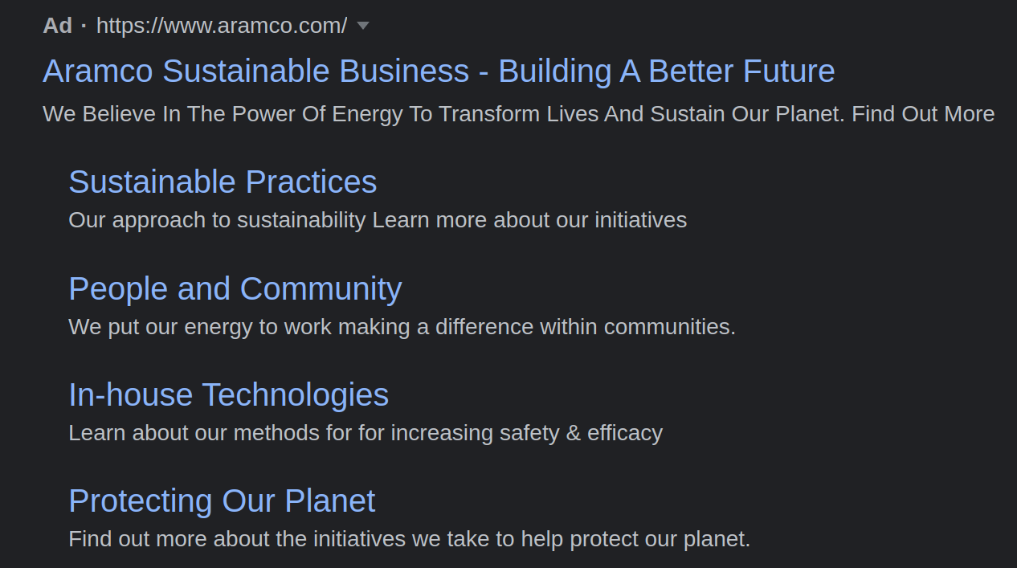
Fun Fact
Google Search Term “sustainable business cooperative”

Slide 49
Fun Fact
Google Search Term “sustainable business cooperative”
100 companies produced more than 70% of the world’s greenhouse gas emissions between 1988 and 2017
Guess who is on the list?
China (Coal) → 14.32%
Saudi Arabian Oil Company (Aramco) → 4.50%
Gazprom OAO → 3.91%
National Iranian Oil → 2.28%
ExxonMobil Corp → 1.98%
Coal India → 1.87%
Petroleos Mexicanos (Pemex) → 1.87%
Russia (Coal) → 1.86%
Royal Dutch Shell PLC → 1.67%
China National Petroleum Corp (CNPC) → 1.56%
BP PLC → 1.53%
Chevron Corp → 1.31%
Blaming individuals and denying any responsibility → great strategy!
https://www.theguardian.com/sustainable-business/2017/jul/10/100-fossil-fuel-companies-investors-responsible-71-global-emissions-cdp-study-climate-change

Slide 50
Act Now
Wales “One Planet Development”
“One Wales: One Planet”
Timeframe → one generation
Goal
Wales should use only its fair share of the earth’s resources
Zero carbon emissions for both use and construction
How?
Low Impact Development principles (applicable in Wales)
Prototypes / Test Communities
Single homes
Co-operative communities
http://www.oneplanetcouncil.org.uk/

Slide 51
Wrap-Up

Slide 52
Wrap-Up
Kate Marvel: “Courage is the resolve to do well without the assurance of a happy ending.”
You do not have to be a sustainability saint → be as sustainable as possible, it still makes a difference
Small progress vs. no progress
Silence/being inactive supports the destruction of our planet (← I just checked, still no “planet B” available)
Do something instead of giving up right away
Leading by example

Slide 53
Thanks!

